Slide 1
Probability and statistics 07-Joint Distribution
상명대학교 휴먼지능정보공학과
2022년 2학기

Slide 2
Joint Distributions
X and Y are jointly distributed random variables.
Discrete: Probability mass function (pmf):
p(x_{i}, y_{j})
Continuous: probability density function (pdf):
f (x, y)
Both: cumulative distribution function (cdf):
F(x, y)= P(X ≤ x, Y ≤ y)

Slide 3
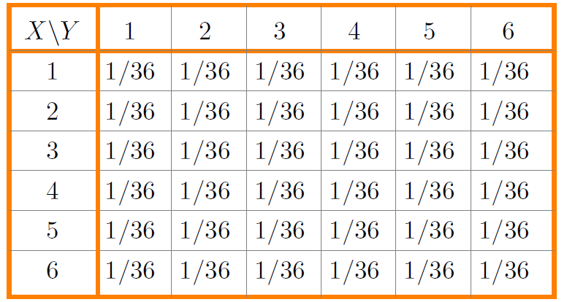
Discrete joint pmf: Example 1
Roll two dice: X = # on first die, Y = # on second die
X takes values in 1, 2, . . . , 6
Y takes values in 1, 2, . . . , 6
Joint probability table:
pmf: p(i, j) = 1/36 for any i and j between 1 and 6.

Slide 4
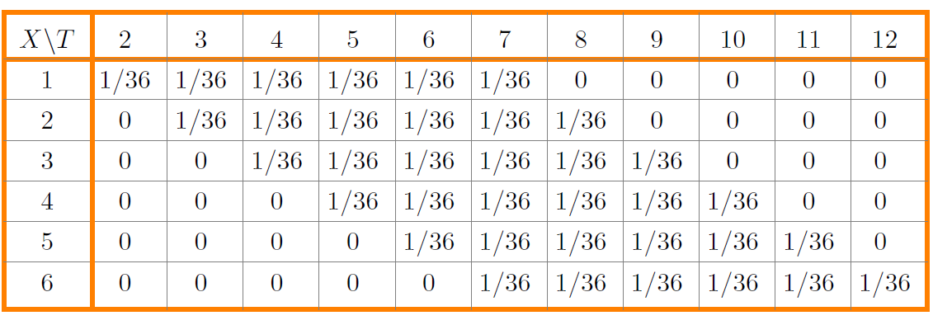
Discrete joint pmf: Example 2
Roll two dice: X = # on first die, T = total on two dice
Joint probability table:

Slide 5
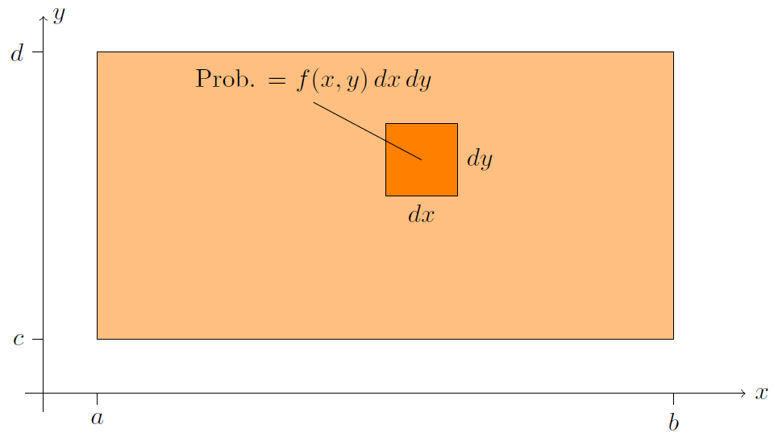
Continuous joint distributions
X takes values in [a, b], Y takes values in [c, d]
(X, Y ) takes values in [a, b] × [c, d].
Joint probability density function (pdf) f (x, y)
f (x, y) dx dy is the probability of being in the small square.

Slide 6
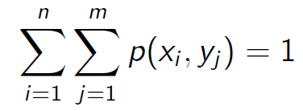
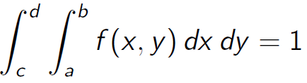
Properties of the joint pmf and pdf
Discrete case: probability mass function (pmf)
0 ≤ p(x_{i}, y_{j}) ≤ 1
Total probability is 1.
Continuous case: probability density function (pdf)
0 ≤ f (x, y)
Total probability is 1.
Note: f (x, y) can be greater than 1: it is a density not a probability.

Slide 7
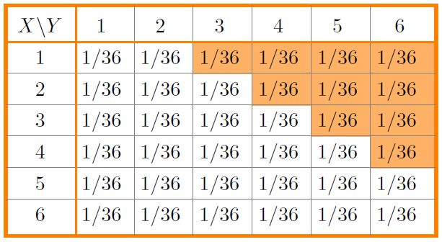
Example: discrete events
Roll two dice: X = # on first die, Y = # on second die.
Consider the event: A = ‘Y − X ≥ 2’
Describe the event A and find its probability.
answer: We can describe A as a set of (X, Y) pairs:
A = {(1, 3), (1, 4), (1, 5), (1, 6), (2, 4), (2, 5), (2, 6), (3, 5), (3, 6), (4, 6)}.
Or we can visualize it by shading the table:

Slide 8
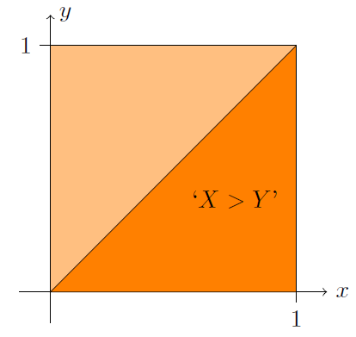
Example: continuous events
Suppose (X, Y ) takes values in [0, 1] × [0, 1].
Uniform density f (x, y) = 1.
Visualize the event ‘X > Y ’ and find its probability.
answer:
The event takes up half the square. Since the density is uniform this is half the probability.
That is, P(X > Y ) = 0.5

Slide 9
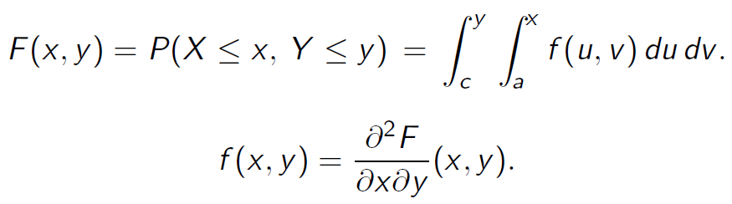

Cumulative distribution function
Properties
F(x, y) is non-decreasing. That is, as x or y increases F(x, y) increases or remains constant.
F(x, y) = 0 at the lower left of its range. If the lower left is (−∞,−∞) then this means
F(x, y) = 1 at the upper right of its range.

Slide 10
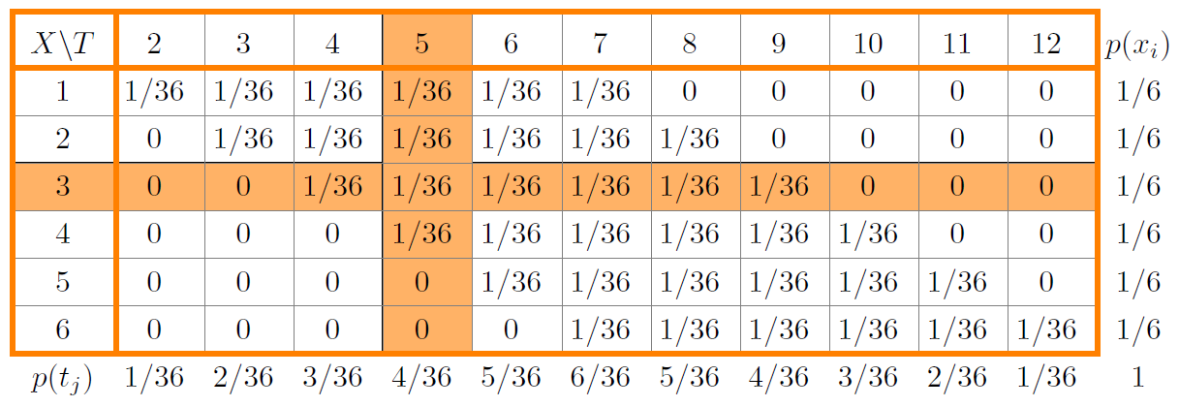
Marginal pmf and pdf
Roll two dice: X = # on first die, T = total on two dice.
The marginal pmf of X is found by summing the rows. The marginal pmf of T is found by summing the columns.
For continuous distributions the marginal pdf f_{X}(x) is found by integrating out the y. Likewise for f_{Y}(y).

Slide 11
Independence
Events A and B are independent if
P(A∩B)= P(A)P(B).
Random variables X and Y are independent if
F(x, y)= F_{X}(x)F_{Y}(y).
Discrete random variables X and Y are independent if
p(x_{i}, y_{j})= p_{X}(x_{i})p_{Y}(y_{j}).
Continuous random variables X and Y are independent if
f(x, y)= f_{X}(x)f_{Y}(y).

Slide 12
Question
Roll two dice: X = # on first die, T = sum
Are X and T independent?
1. Yes 2. No

